Slide 1




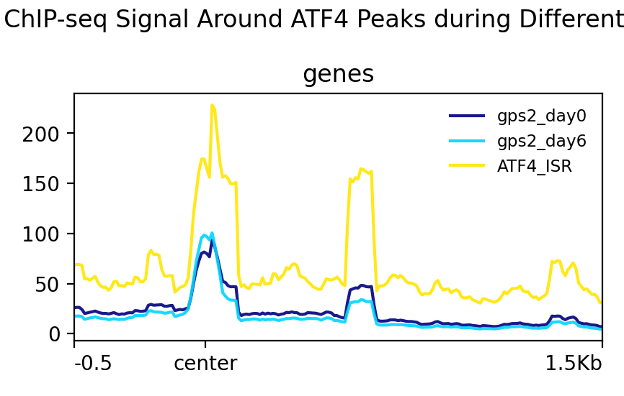
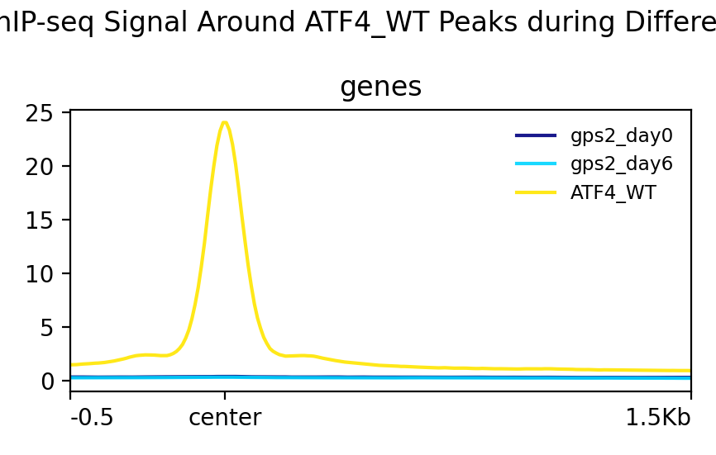
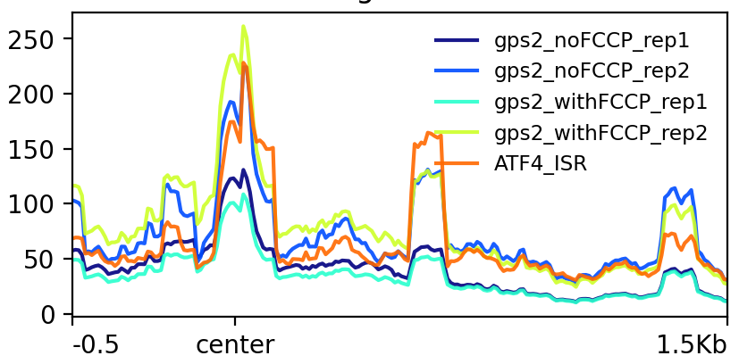
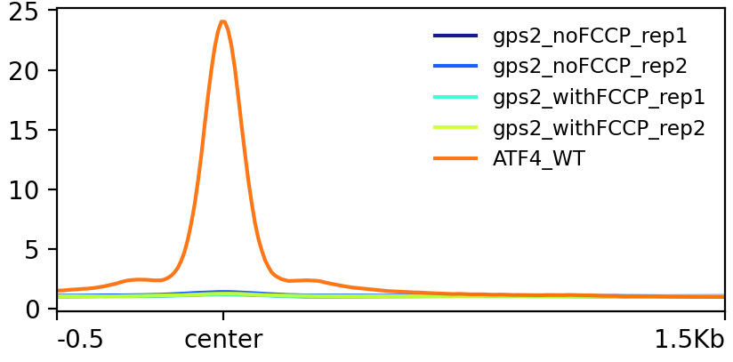
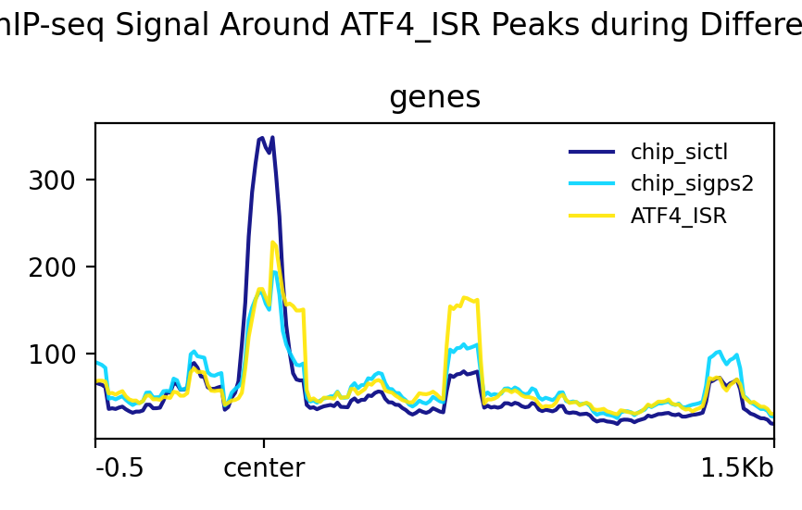
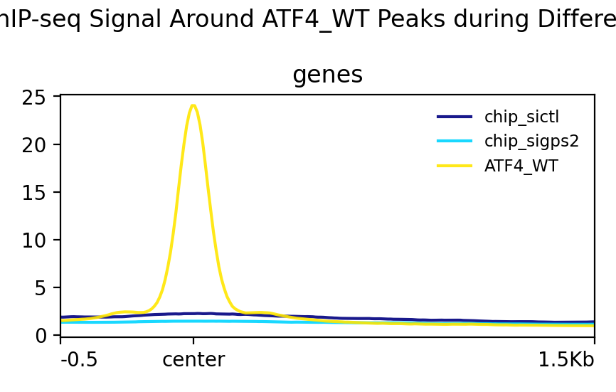
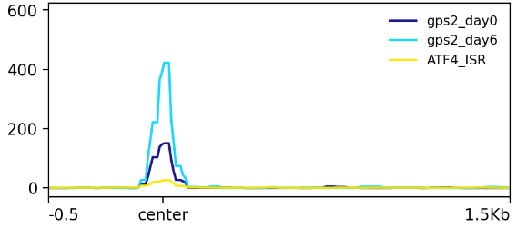
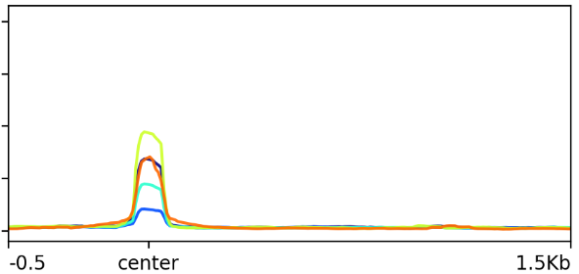
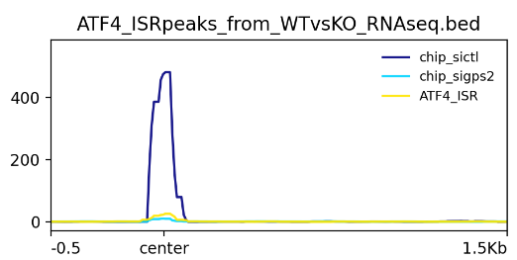
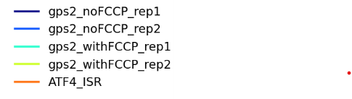
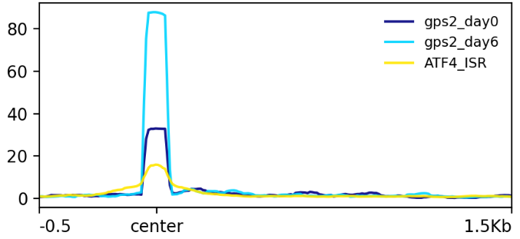
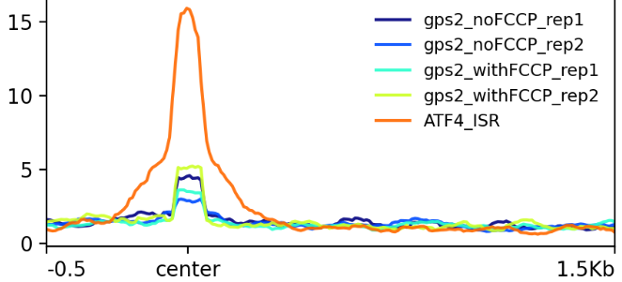
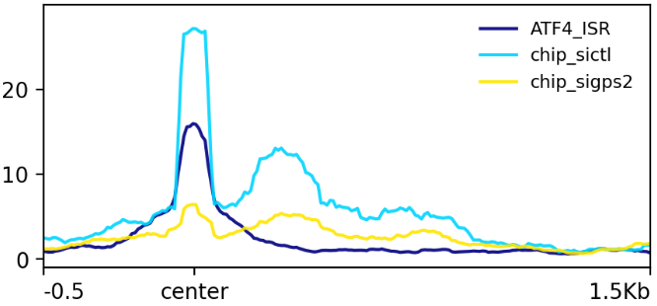
Exploring GPS2 and ATF4 Crosstalk in Mitochondrial Stress Response
Github
Contact
Jawahar Mahendran¹, Valentina Perissi² and Joseph Orofino³
1. Masters Student, Bioinformatics, Faculty of Computing and Data Science, Boston University
2. Department of Biochemistry and Cell Biology, Chobanian and Avedisian School of Medicine, BUSM
3. Faculty of Computing and Data Science, Bioinformatics, Boston University
Abstract
Methodology
Results
Conclusion
Table 1: Overlap of ATF4 and GPS2 Peaks across different conditions with percentages indicating the predominant peak annotations.
Figure 1: Plot Profiles of GPS2 and ATF4 Signals Across Different Conditions This figure presents the plot profiles of GPS2 and ATF4 signals, segmented by experimental conditions. Each plot centers on ATF4 peaks, allowing for a comparison of signal intensities and distributions relative to ATF4 binding sites. The profiles illustrate how GPS2 binding behavior varies across the different conditions, revealing the interaction between GPS2 and ATF4 under specific cellular contexts.
The analysis of peak overlaps between ATF4 and GPS2 under varying conditions provides valuable insights into their interplay, particularly within the context of mitochondrial stress and cellular differentiation. The consistent overlap of peaks between ATF4 in the amino acid-deprived state (AAD) and GPS2 during differentiation, coupled with the prominent enrichment of mitochondrial UPR pathways in the GSEA results, suggests a coordinated role for GPS2 and ATF4 in mediating stress and differentiation responses. The lack of overlap between ATF4 in AAD and GPS2 under mitochondrial stress induced by FCCP is surprising, especially given the detectable GPS2 signals in the plot profiles (Table 1 and Figure 2a). Furthermore, the observed increase in peak intensity for GPS2 on day 6 compared to day 0, aligned with RNA-seq data^{[3,4]}, reinforces the notion of GPS2's dynamic regulation during differentiation. Collectively, these findings highlight GPS2's potential role in modulating ATF4 activity in response to cellular stress and differentiation, with a particular emphasis on mechanisms associated with the mitochondrial UPR.
Mitochondrial function requires precise coordination between mitochondrial and nuclear genomes. This study focuses on GPS2 (G-protein Pathway Suppressor 2), a key mediator of mitochondrial retrograde signaling. We hypothesize that GPS2 is recruited to nuclear stress response genes through interactions with the transcription factors ATF3, ATF4, and ATF5. Through the integration of ChIP-seq data, we have identified key co-regulated genes, indicating a coordinated role for GPS2 and ATF4 in regulating mitochondrial stress responses, with evidence suggesting potential direct interactions between GPS2 and ATF4.
 | ATF4
GPS2 | Amino Acid Deprivation (ATF4_ISR) (525) | ER Stress (ATF4_WT) (20639)
GPS2_day0 (11917) | 387 Distal intergenic(50%) | 266 Promoter(83%)
GPS2_day6 (44523) | 378 Distal intergenic(51%) | 691 Promoter(76%)
GPS2_withFCCP (2623) | 0 | 10 Promoter(40%)
GPS2_siCTL (10059) | 111 Distal intergenic(40%) | 301 Promoter(95%)
Adipocyte - Differentiation
Differentiation
Treatment
2. Mitochondrial Stress
Wild-type
Table 2: Representative GSEA results of the overlapping peaks from MSIGDB
Gene Set Enrichment
HALLMARK UNFOLDED PROTEIN RESPONSE
HALLMARK_MTORC1_SIGNALING
HALLMARK INTERFERON GAMMA RESPONSE
HALLMARK PI3K AKT MTOR SIGNALING
HALLMARK APICAL SURFACE
HALLMARK_UV_RESPONSE_UP
3. GPS2-silencing
Introduction
Mitochondria depend on the nuclear genome for most of their proteome, requiring precise coordination of gene expression via anterograde and retrograde signaling pathways. GPS2 plays a crucial role in retrograde signaling, especially under mitochondrial stress^{[1]}. It is hypothesized that GPS2 interacts with bZIP transcription factors such as ATF3, ATF4, and ATF5, which are integral to stress response pathways, including the mitochondrial unfolded protein response (mtUPR)^{[2]}. Understanding GPS2's recruitment mechanisms with these transcription factors could be essential for understanding mitochondrial stress responses and has implications for metabolic diseases, aging, and cancer.
Figure 2: Plot Profiles of GPS2 and ATF4 Signals Across Conditions upon comparison with ATF4-RNA seq data
This figure presents the plot profiles of GPS2 alongside ATF4_ISR (Amino Acid Deprivation) signals, segmented by experimental conditions. Each plot is centered on ATF4 peaks associated with differentially expressed genes identified from RNA-seq experiments. The profiles illustrate the variability in GPS2 binding behavior across different conditions, with a specific focus on genes that are differentially expressed under conditions similar to those in the GPS2 experiments.
GPS2 conditions
RNA-seq conditions
Differentiation
Mitochondrial Stress
GPS2-silencing
References
ER stress through Tunicamycin
Cardamone MD, Tanasa B, Cederquist CT, et al. Mitochondrial Retrograde Signaling in Mammals Is Mediated by the Transcriptional Cofactor GPS2 via Direct Mitochondria-to-Nucleus Translocation. Mol Cell. 2018;69(5):757-772.e7. doi:10.1016/j.molcel.2018.01.037
Melber A, Haynes CM. UPRmt regulation and output: a stress response mediated by mitochondrial-nuclear communication. Cell Res. 2018;28(3):281-295. doi:10.1038/cr.2018.16
Margaret E Torrence, Michael R MacArthur, Aaron M Hosios, Alexander J Valvezan, John M Asara, James R Mitchell, Brendan D Manning (2021) The mTORC1-mediated activation of ATF4 promotes protein and glutathione synthesis downstream of growth signals eLife 10:e63326
Fusakio, M. E., Willy, J. A., Wang, Y., Mirek, E. T., Al Baghdadi, R. J., Adams, C. M., Anthony, T. G., & Wek, R. C. (2016). Transcription factor ATF4 directs basal and stress-induced gene expression in the unfolded protein response and cholesterol metabolism in the liver. Molecular biology of the cell, 27(9), 1536–1551. https://doi.org/10.1091/mbc.E16-01-0039
mTORC1 signaling (Differentiation)

